Slide 1
Graduation Reply
Garbage Classifier based on Resnet50
STUDENT:Xiaoping Shen Wenxuan Ye Shiyuan Fang
Yijin Huang Shangzhi Liu Tailin Song

Slide 2
1
Background and significance of the topic
2
The source of the dataset
CONTENTS
3
The model used in study
4
Model training and testing
5
Summary and Prospect

Slide 3
1.Group members and division of labor
Name | Division of labor
Xiaoping Shen | Project selection, Presentation , Debugging code and test the model, Making PPT
Shangzhi Liu | Make PPT,debugging code and collection of relevant materials
Shiyuan Fang | Project selection, presentation and enrichment of data sets
Yijin Huang | Make PPT , model invocation and testing
Tailin Song | Presentation, read papers and gather data
Wenxuan Ye | Make PPT, enrich of data sets and debugging code
Background
The source of the dataset
The model used in study
Model training and testing
Summary and Prospect

Slide 4
1. Background and significance of the topic
At the same time, environmental protection is also a hot topic in today's world. The program of garbage classifier helps people to classify the garbage generated by the family more quickly, saves everyone's experience and time, objectively-promotes the popularity of garbage classification, and also makes a certain contribution to environmental protection.
On July 1,2019,Shanghai announced a garbage sorting system.Individuals will face fines if they do not separate their garbage. But for most people,they still don’t know much about garbage classification.Therefore, the preparation of a garbage classification program is very necessary.
Background
The source of the dataset
The model used in study
Model training and testing
Summary and Prospect

Slide 5
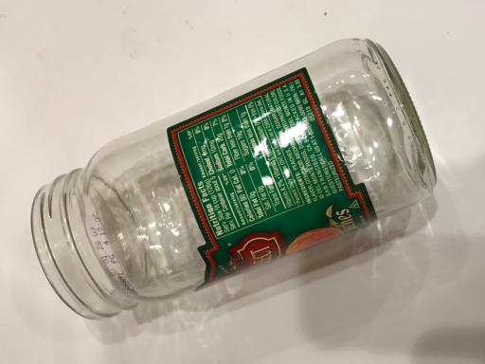
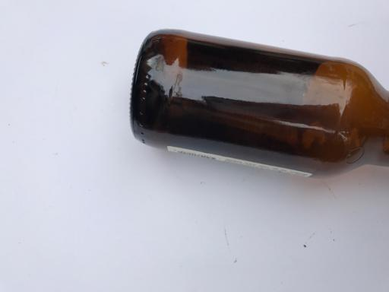
2. The source of the dataset
Background
The source of the dataset
This project is from GitHub, and no one has written relevant software and data before the author. Most of the training data set of this project comes from Kaggle, and our group added a few pictures.
The model used in study
Model training and testing
Summary and Prospect

Slide 6
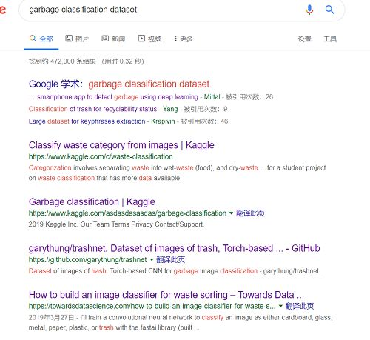
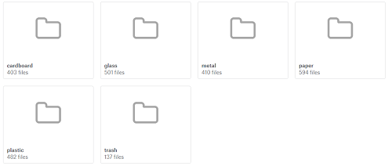
2. The source of the dataset
Finding relevant data sets is difficult, and
while there are many articles on Google, most are not open source. Eventually the authors decided to use this for the Kaggle dataset. Due to its small size, our team added a few pictures to facilitate further training of the model.
Background
The source of the dataset
The datasets fall into six main categories: cardboard
glass
metal
paper
plastic
trash
The data distribution is shown on the left.
The authors randomly selected 2000 images as the training set and the remaining 527 as the test set.
The datasets fall into six main categories: cardboard
glass
metal
paper
plastic
trash
The data distribution is shown on the left.
The authors randomly selected 2000 images as the training set and the remaining 527 as the test set.
The model used in study
Model training and testing
Summary and Prospect

Slide 7
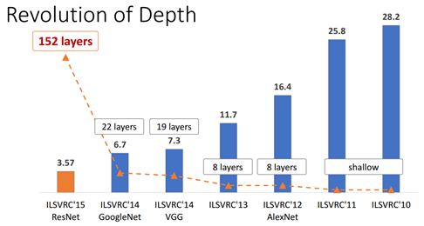
3. ResNet
Deep residual network (ResNet), proposed by He Kaiming, is a milestone event in the history of CNN images. ResNet addresses the difficulty of training deep CNN models.
Background
The source of the dataset
The model used in study
Model training and testing
It can be seen from the figure that the 14-year VGG has only 19 layers, while the 15-year ResNet has as many as 152 layers. However, ResNet not only wins by depth, but also has an architectural trick, which is Residual learning.
Summary and Prospect

Slide 8
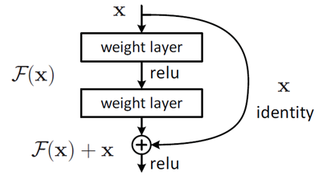
3. ResNet
Residual learning
For a stacked layer structure (several layers stacked), when the input is x, the learned feature is recorded as H (x) , and now we hope that it can learn the residual = H (x)-x , so that the original learned feature is F (x)+x .
Background
The source of the dataset
The model used in study
The reason for this is that residual learning is easier than direct learning from raw features. When the residual is 0, the stacking layer only does the identity mapping at this time, at least the network performance will not be degraded, in fact the residual will not be 0, which will also make the stacking layer learn new features based on the input features , resulting in better performance.
Model training and testing
Summary and Prospect

Slide 9
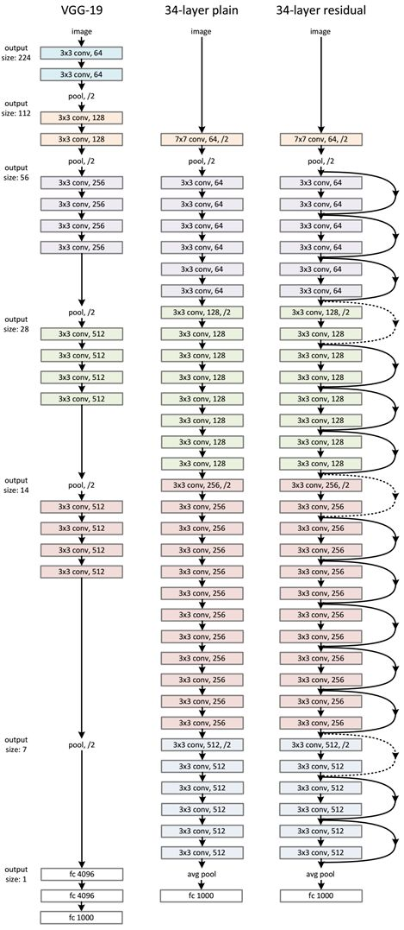
3. ResNet
Network structure
The ResNet network refers to the VGG19 network, modified it on the basis, and added a residual unit through a short-circuit mechanism.
Background
The change is mainly reflected in the fact that ResNet directly uses the convolution of stride=2 for downsampling, and replaces the fully connected layer with the global average pool layer.
The source of the dataset
The model used in study
Model training and testing
Summary and Prospect

Slide 10
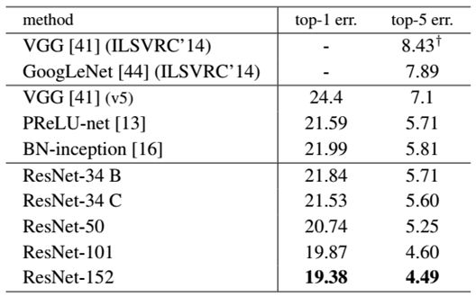
3. ResNet
The comparison results of the ResNet network and other networks on ImageNet are shown in Table 2. It can be seen that the error of ResNet-152 is reduced to 4.49%, and when the ensemble model is used, the error can be reduced to 3.57%.
Background
The source of the dataset
The model used in study
Model training and testing
Summary and Prospect
Therefore, we choose ResNet as the network model.

Slide 11
4.Model Training
We faced a lot of Problems.
For example: CUDA out of memory
Install and build the PyTorch runtime environment
Background
The source of the dataset
The model used in study
However, Fortunately, we all succeeded in solving these problems in the end.
For example: We adjusted the parameters of the program, such as “batch-size” and “epoch”.
Model Training and Testing
Summary and Prospect

Slide 12
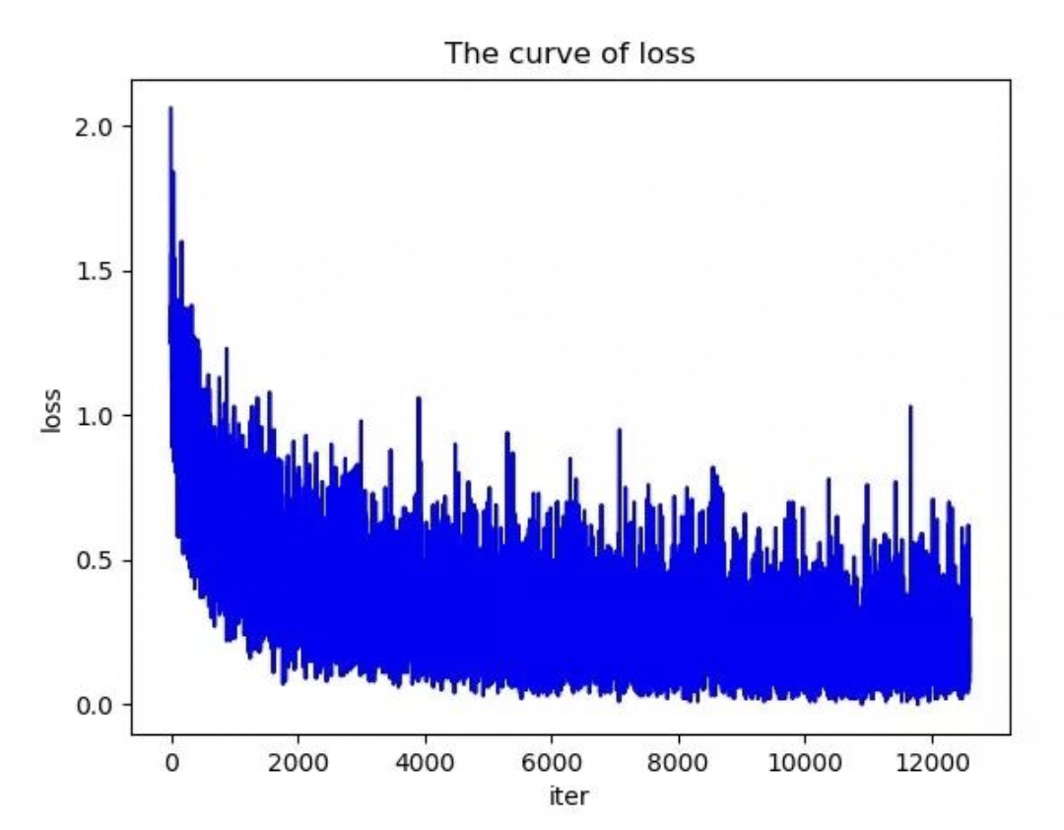
4.Model Training
Loss curve of training
Background
The source of the dataset
The model used in study
Model Training and Testing
Summary and Prospect

Slide 13
4.Model Training
Background
Model Testing
Xiaoping Shen
The source of the dataset
The model used in study
Model Training and Testing
Summary and Prospect

Slide 14
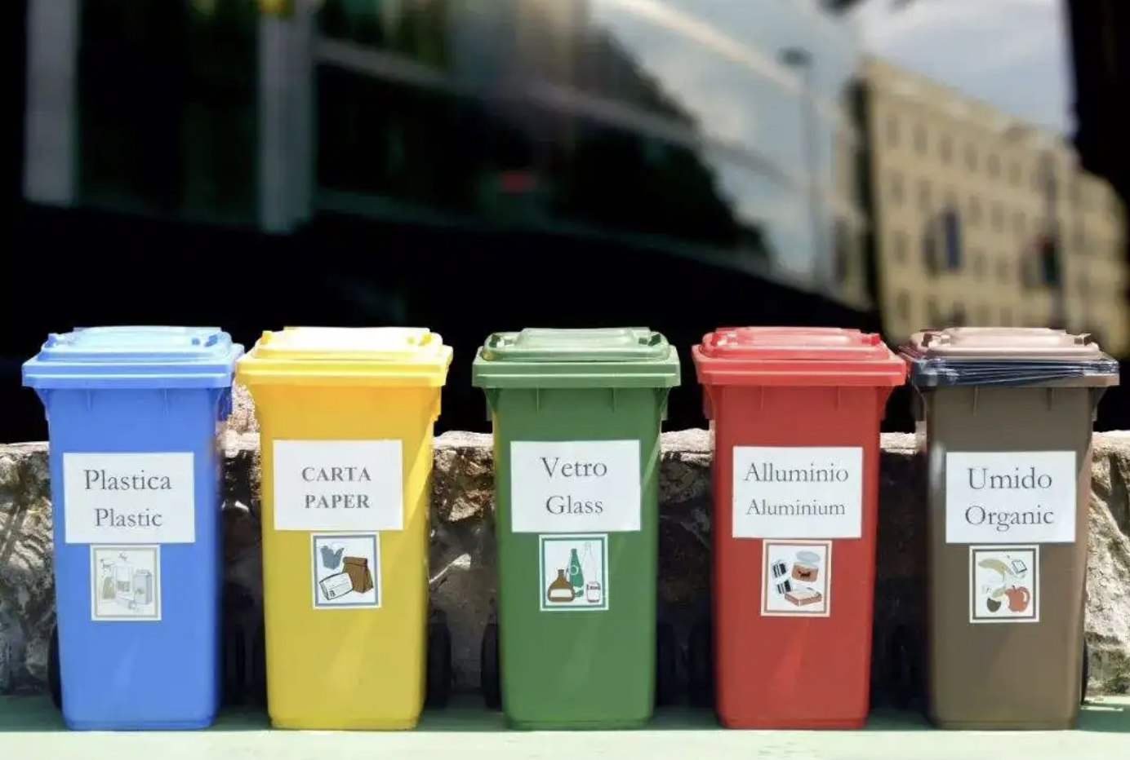
5.Summary
Background
The source of the dataset
The model used in study
Garbage Classifier
Model Training and Testing
Cultivate a green and healthy lifestyle.
Garbage classification is an important way and means to realize garbage reduction and recycling
Summary and Prospect

Slide 15
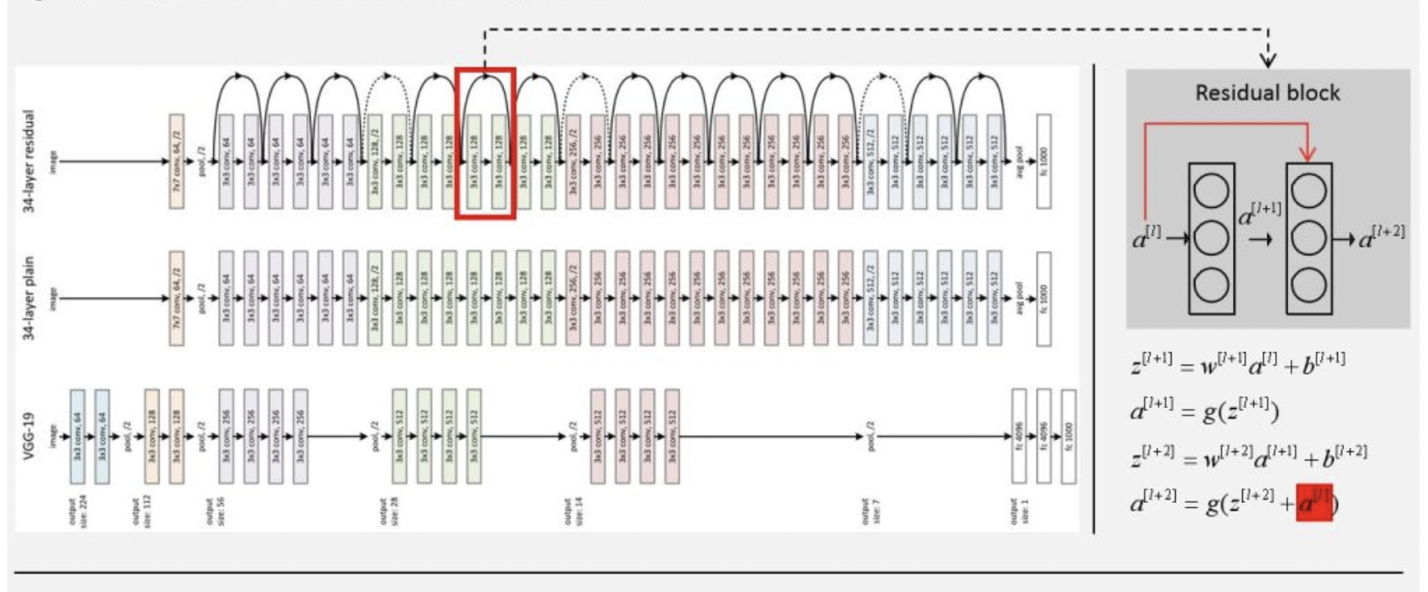
5.Summary
Background
The source of the dataset
The model used in study
Common CNN model-ResNet
Model Training and Testing
Relatively easier to train very deep (e.g. more than 100 layers) neural.
Good performance on training error when it is used to train deep neural networks.
Summary and Prospect

Slide 16
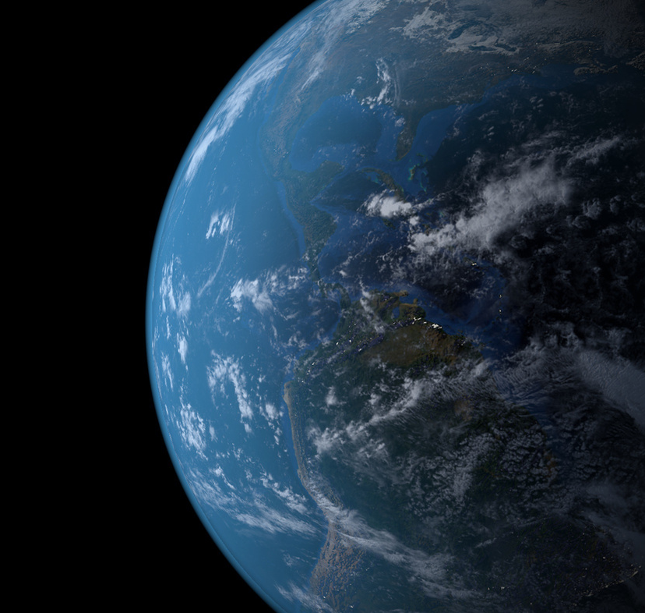
5.Summary
With the progress of Artificial Intelligence technology and the in-depth promotion of garbage classification, the application of AI to garbage classification will be the general trend in the future.
Perhaps in the near future, we can use AI to achieve a full chain of unmanned garbage sorting system.
Background
The source of the dataset
The model used in study
Model Training and Testing
Summary and Prospect

Slide 17
Acknowledgements
From topic selection to data collection and finally to the completion of the exhibition. Thank to Assoc Prof Kwoh Chee Keong for your valuable knowledge, which has greatly helped our group's research. Thank the team members for their unity and cooperation to successfully complete the project.

Slide 18
Thank you for watching！
NTU-Artificial Intelligence and Machine Learning-Group 1

